Slide 1

Investigation of Stability Trends in Bimetallic CuAg, CuAu, and AgAu Nanoparticles via Bond-Centric Model
Mahmoud Ramadan, James Dean, Jon Estes, Giannis Mpourmpakis (PI)
PFM REU
August 1, 2018
Computer-Aided Nano and Energy Lab (CANELA)
Notes:
Instructions for editing school and department titles:
Select from menu: View > Master > Slide Master
Click on each text area you wish to edit. Text will become editable.

Slide 2
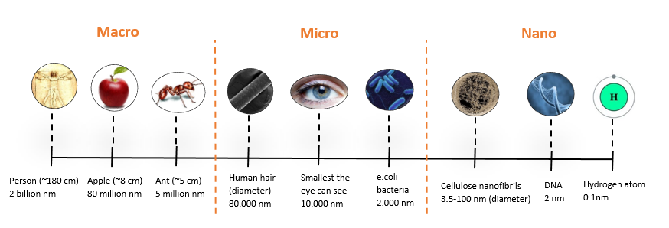
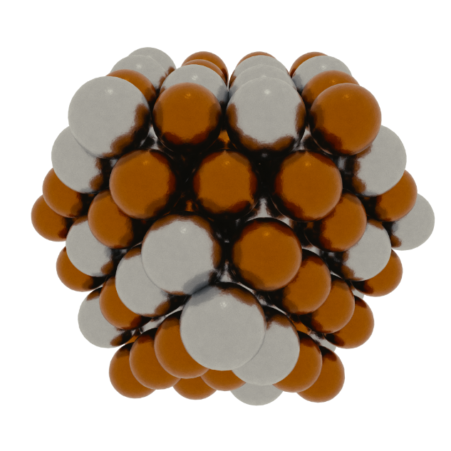
Nanoparticles (NPs)
Nanoparticles: clusters in the nanoscale
High surface to volume ratio
Access to low coordination sites
More control over local chemical environment
Source: Wikimedia Commons
Notes:
NP are particles between 1 and 100 nm in size
The human eye can only see up to the micro scale, and can identify strand of hair is about 65 microns or micrometers
Low coordination sites are morereactive than high coordaintion (found in larger metals)

Slide 3
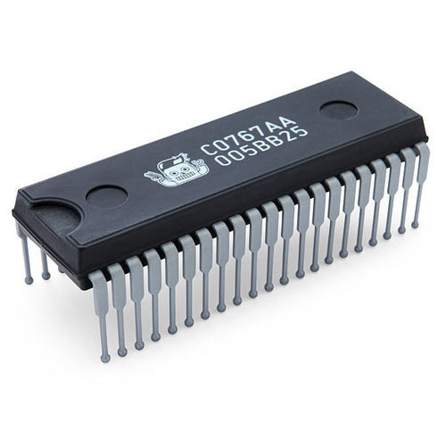

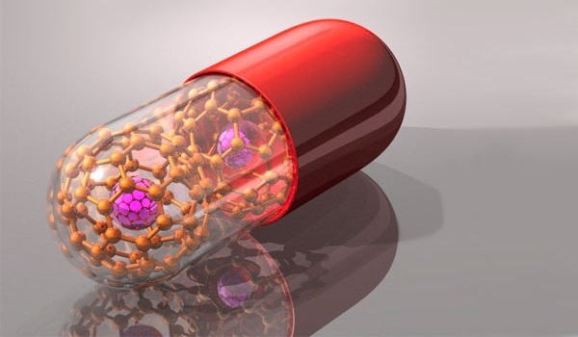
Applications
Electronics¹
Integrated circuits and transistors
Optics¹
Colorings in stained glass
Catalysis²
Adsorption
Activation of molecules
Medicine³:
Drug delivery
Novel drugs
Source: Wikimedia Commons
Source: Wikimedia Commons
Source: The Scientist. Cover. August 2014.
Notes:
They have numerous applications in electronics , optics, catalysis , and medicine
Electronics : using silicon-on-oxide
Optics : glass artisans were making stained glass windows from coinage metals

Slide 4
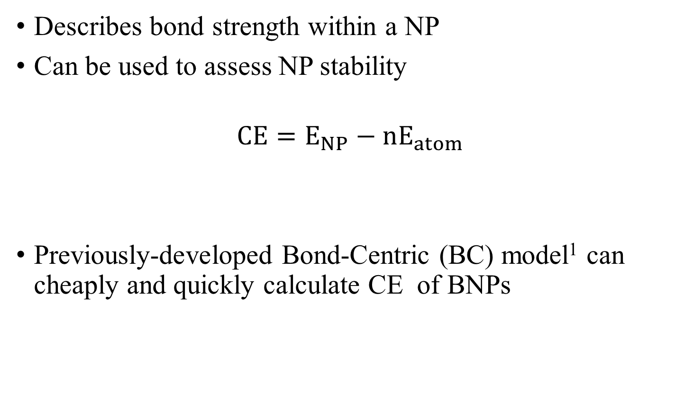
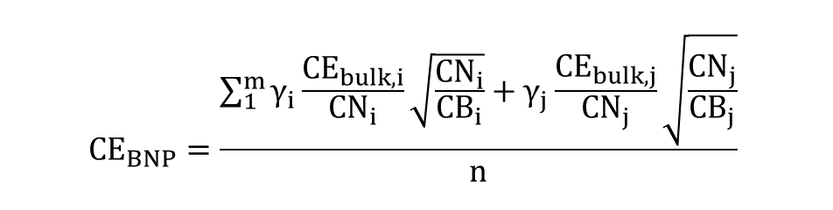
Cohesive Energy (CE)
Describes bond strength within a NP
Can be used to assess NP stability
$$CE=E_{NP}−nE_{atom}$$
Previously-developed Bond-Centric (BC) model¹ can cheaply and quickly calculate CE of BNPs
$${CE}_{BNP}=\frac{\sum_{1}^{m}{γ_{i}}\frac{{CE}_{bulk,i}}{{CN}_{i}}\sqrt{\frac{{CN}_{i}}{{CB}_{i}}}+γ_{j}\frac{{CE}_{bulk,j}}{{CN}_{j}}\sqrt{\frac{{CN}_{j}}{{CB}_{j}}}}{n}$$
Notes:
Cohesive energy is the energy gained or lost by arranging the atoms in a crystalline state, as compared with the gas state
The more negative the cohesive energy, the more stable
Can be used to compare NP of different structures within the same composition
Quantum chemistry methods, such as DFT , are usally used to calculate the energies of NPs, but they are computationally expensive , so instead

Slide 5
Aims
Investigate composition and morphology of Bimetallic NPs (BNPs)
Monte Carlo sampling of different NPs
BC model¹ to determine NP stability
Determine preferred chemical ordering in BNP
Overall: Identify most thermodynamically stable BNPs

Slide 6
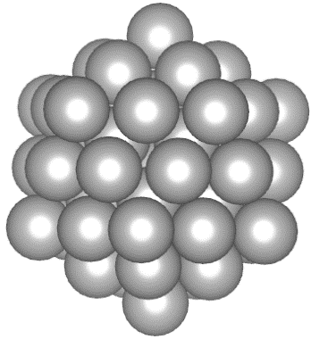
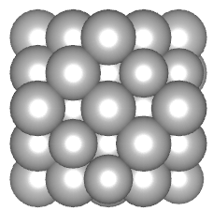
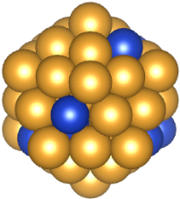
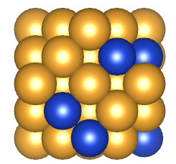
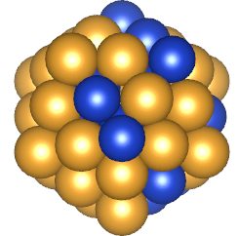
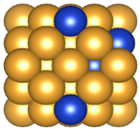
Algorithm
Select morphology
Select composition
Assign random chemical ordering
Calculate CE using BC Model

Slide 7
Methods
Atomic Simulation Environment as implemented in Python to generate BNPs
CE of BNPs was calculated using BC model¹
Monte Carlo Sampling
55- and 147-atom NPs
Icosahedral and cuboctahedral NPs
CuAg, CuAu, AgAu
0-100% dopant, in 5% increments
55-atom BNPs: 350,000 chemical orderings/composition
147-atom BNPs: 1,000 chemical orderings/composition
Notes:
ASE Was implemented in python to generate the NP
BC model was used to cheaply and quickly calculate the CE , allowing us to screen 10000s of NPs and determine their

Slide 8
CE Plot of CuAg
Average CE decreases (more exothermic) as the Cu composition increases in CuAg BNPs

Slide 9
CE Plot of AgAu
Average CE increases (less exothermic) as the Ag composition increases in AgAu BNPs

Slide 10
CE Plot of CuAu
Average CE increases (less exothermic) as the Cu composition increases in CuAu BNPs
Notes:
There is a minimum , but it doesn’t tell us much on the stability with respect to other compositions so instead

Slide 11
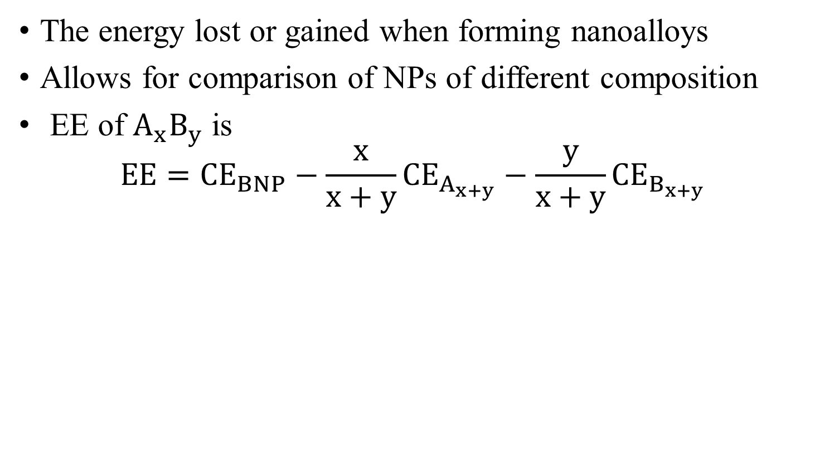
Excess Energy (EE)
The energy lost or gained when forming nanoalloys
Allows for comparison of NPs of different composition
EE of $A_{x}B_{y}$ is
$$EE={CE}_{BNP}−\frac{x}{x+y}{CE}_{A_{x+y}}−\frac{y}{x+y}{CE}_{B_{x+y}}$$

Slide 12
EE Plot (Metal Mixing)
Thermodynamically disfavorable formation of CuAg 55- or 147-atom icosahedral and cuboctahedral BNPs
Favorable formation of 55- and 147-atom CuAu and AgAu icosahedral/cuboctahedral BNPs

Slide 13
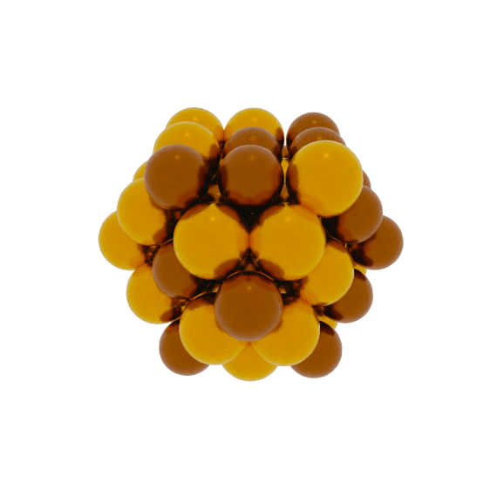
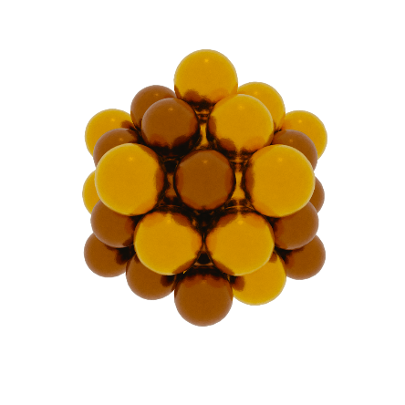
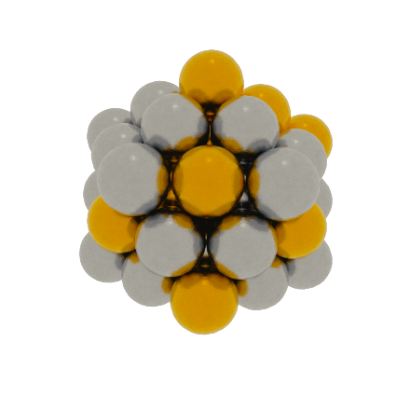
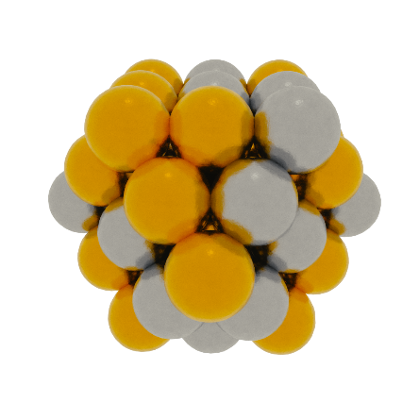
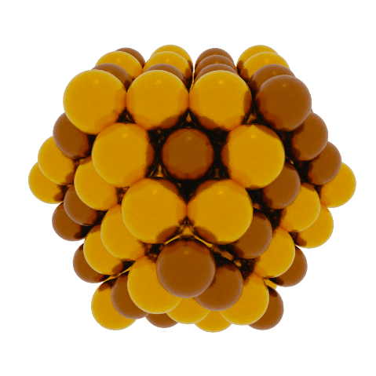
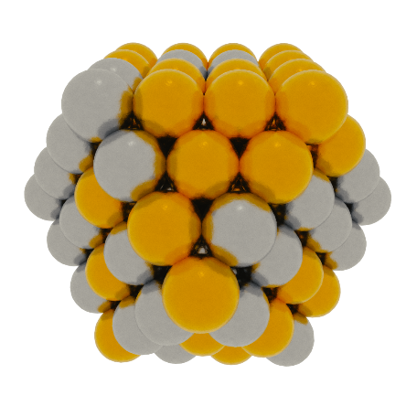
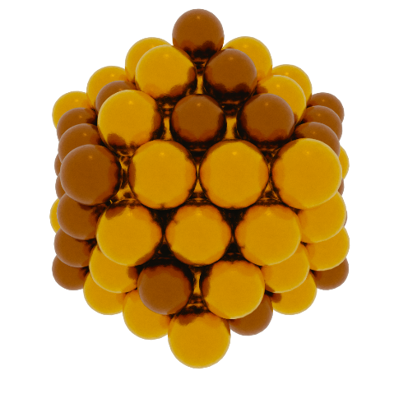
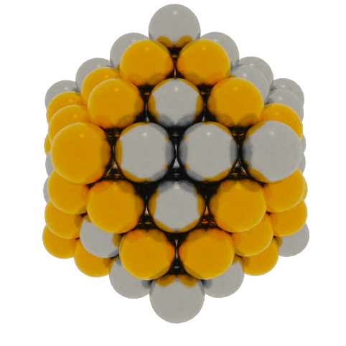

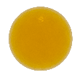

Predicted Structures
Cu
Au
Ag
Minimum-energy structures of the 55- and 147-atom cuboctahedral and icosahedral 50/50 CuAu and 50/50 AgAu BNPs

Slide 14
Summary
Investigated BNP stability using BC model¹
Compared different chemical orderings within the same composition
Identified the favorable formation of 55- and 147-atom icosahedral/cuboctahedral CuAu and AgAu BNPs
Future Work: Incorporate symmetry operations to simulate BNPs of larger size and to decrease the search space

Slide 15



Acknowledgement
Everyone at CANELA
Dr. Michail Stamatakis (University College London)
Dr. Tayrn Bayles and Dr. Joe McCarthy
Grant Number CMMI-1634880
Grant Number ECC-1659324

Slide 16
Questions ?

